Slide 1






Cross platform form generator with schema driven automation
25-26J-436
Mr. Jeewaka Perera Lecturer Faculty of Computing | Computer Science
Ms. Thilini Jayalath Senior Lecturer Faculty of Computing | Software Engineering
Dissanayake D. M. T. V.
(Leader)
IT22003546
Gunawardena T. S.
IT22350114
Rajapakshe P. H. Y. L.
IT22305350
Liyanage M. I. H.
IT22332608
25-26J-436

Slide 2


PROBLEM
IMPACT
Manual schema and form creation
Frontend-backend validation duplication
Accessibility handled inconsistently
Manual and error-prone data mapping
Fragmented form development tools
Inconsistent behaviour across layers
Increased development and maintenance cost
Accessibility compliance risks
Validation and data errors
Limited scalability for form-heavy systems
WHO IS AFFECTED
Developers, QA teams, enterprise IT departments, and end users
25-26J-436

Slide 3
PROPOSED SOLUTION
Single intelligent schema as the source of truth
Automated frontend form generation with WCAG 2.1 compliance
Automated backend API and DTO generation
Synchronized validation and data mapping across layers
AI-assisted test case generation
Visual drag-and-drop customization
25-26J-436

Slide 4
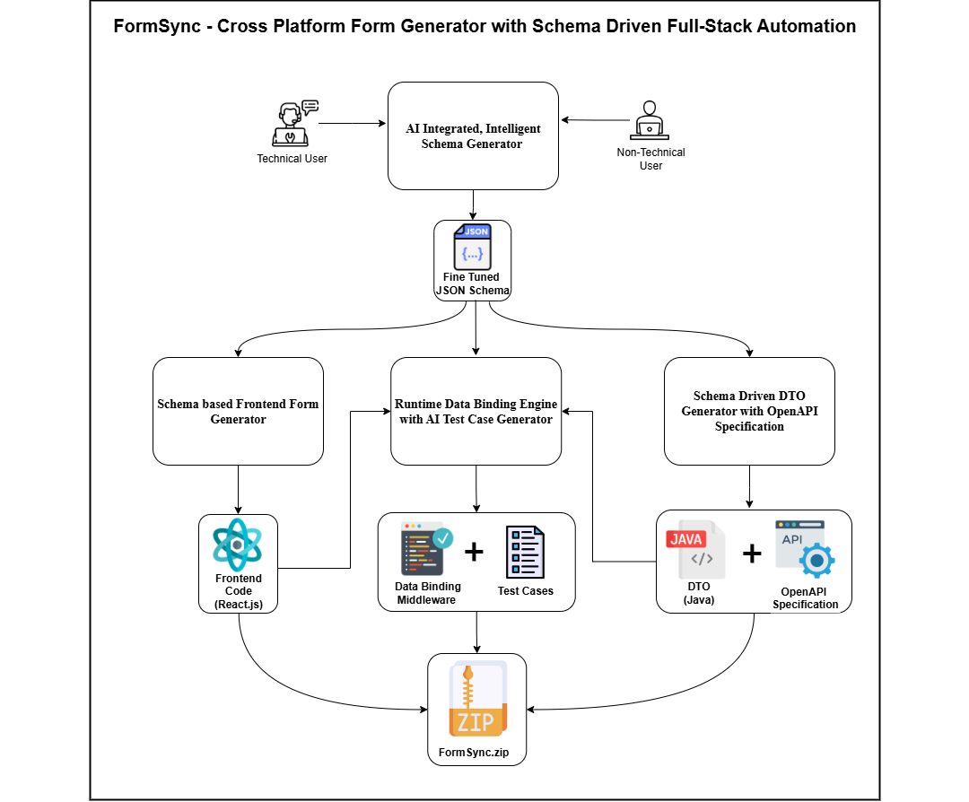
SYSTEM OVERVIEW DIAGRAM
Figure 1 - System Overview Diagram - Cross Platform Form Generator with Schema Driven Automation
25-26J-436

Slide 5
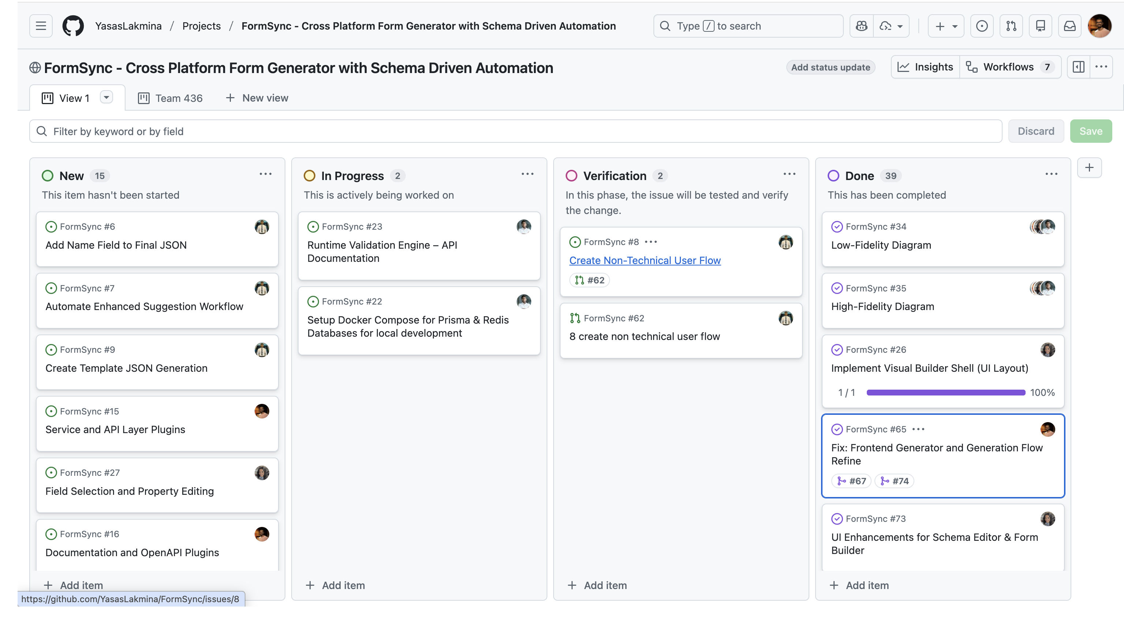
PROJECT MANAGEMENT
Figure 2: GitHub-based project management board used to track tasks, progress, verification, and completed milestones of the FormSync system.
25-26J-436

Slide 6
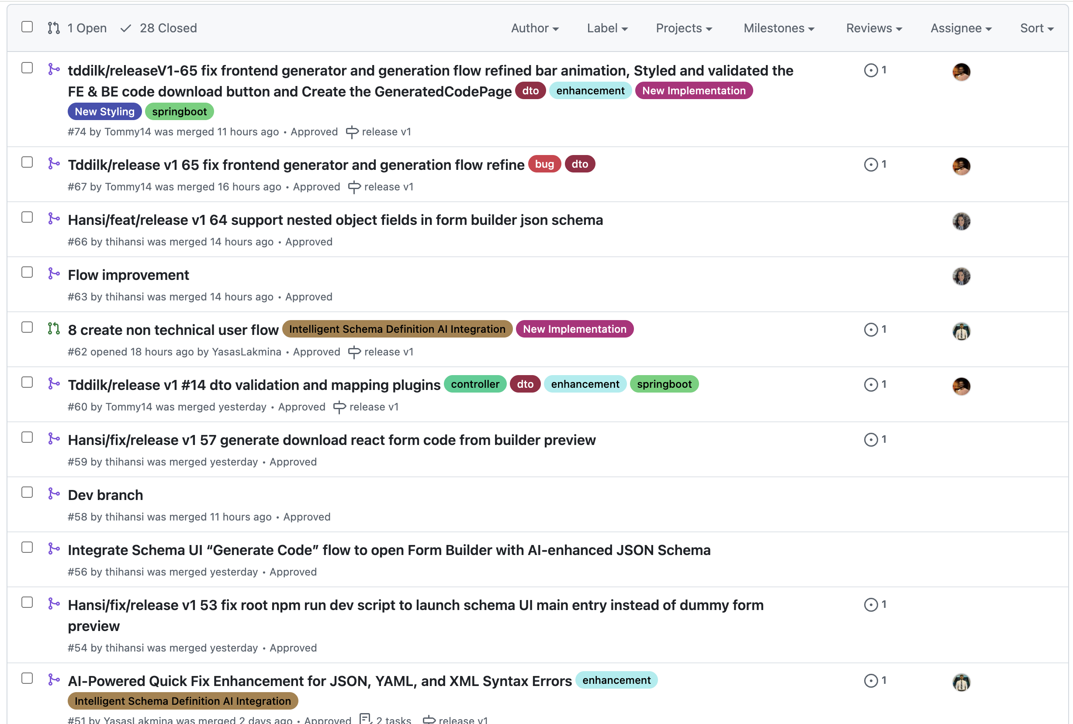
PROJECT MANAGEMENT
Figure 3: GitHub issue and pull request history used to manage and track development progress.
25-26J-436

Slide 7
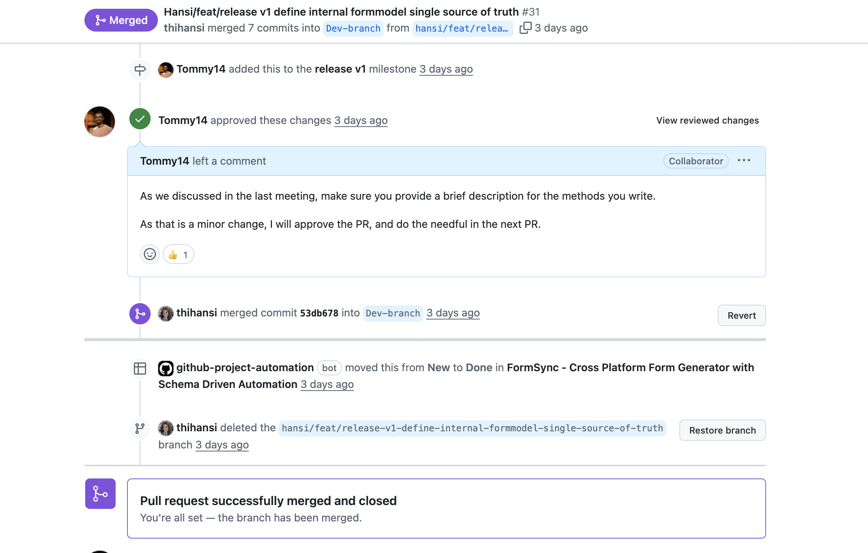
PROJECT MANAGEMENT
Figure 4: GitHub pull request showing review, approval, and merge process.
25-26J-436

Slide 8

IT22305350 | Rajapakshe P H Y L
INTELLIGENT SCHEMA DEFINITION & AI INTEGRATION
Software Engineering
IT22305350 | Rajapakshe P H Y L | 25-26J-436

Slide 9
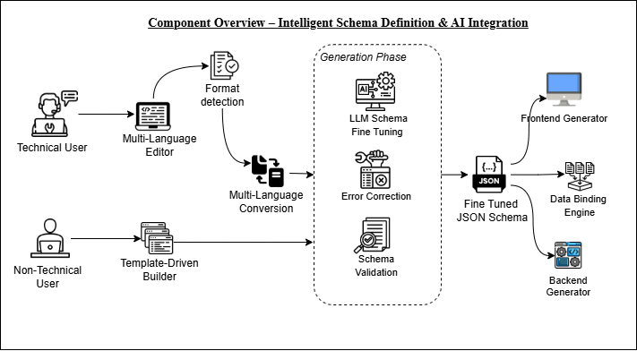
SOLUTION & USER REQUIREMENTS
INTELLIGENT SCHEMA DEFINITION & AI INTEGRATION
System Overview Diagram
User / Functional Requirements
Multi-format input support (JSON/YAML/XML).
Rule Base schema validation and quick fix.
AI-powered schema enhanced suggestions
Dual interface: Technical Editor (Monaco) and visual Template Builder for non-technical users
Rule base Schema Quality Scoring.
User Requirement Addressed
Fast schema creation
AI-assisted schema enhancement.
JSON / YAML / XML format support
Reduced effort through template-based schema building.
Figure 5: System Overview – Intelligent Schema Definition and AI Integration
IT22305350 | Rajapakshe P H Y L | 25-26J-436

Slide 10
DESIGN EXCELLENCE & CONTRIBUTION
INTELLIGENT SCHEMA DEFINITION & AI INTEGRATION
Design Excellence
Clear separation between:
Non-technical flow
Technical schema editor
Reusable validation and enhancement services
Multi-format conversion engine.
Scalable for future features
Already Implemented:
Multi-format schema parsing and conversion with format detection.
AI-assisted schema enhancement and provide suggestions.
Schema validation and quick fix for syntax errors.
Rule base schema quality scoring system.
Interactive Schema Tree View for schema navigation
To be Implemented:
Non-technical flow with UI refinements.
Custom template creation and sharing.
Enhance rule base quality engine to increase the schema accuracy.
IT22305350 | Rajapakshe P H Y L | 25-26J-436

Slide 11

IT22003546 | Dissanayake D M T V
Schema-driven Backend Generator For Automated DTO And OpenAPI Specification Creation
Software Engineering
IT22003546 | Dissanayake D M T V | 25-26J-436

Slide 12
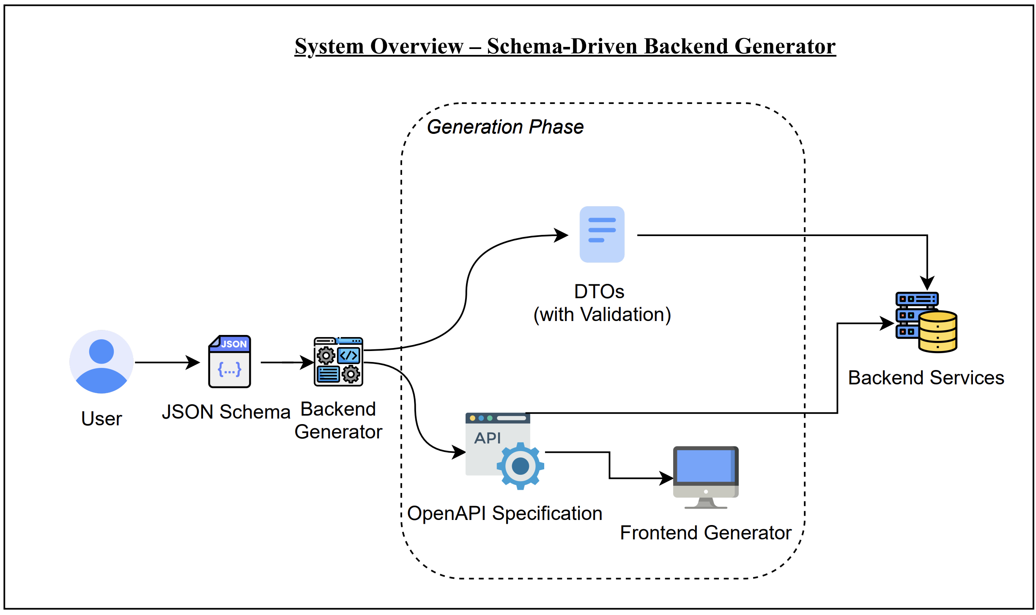
SOLUTION & USER REQUIREMENTS
SCHEMA-DRIVEN BACKEND GENERATOR FOR AUTOMATED DTO AND OPENAPI SPECIFICATION CREATION
System Overview Diagram
User / Functional Requirements
Auto-generates Spring Boot backend from validated JSON Schema
Removes manual boilerplate coding
Ensures schema-based validation across layers
Uses plugin-based backend generation
Produces ready-to-run backend services
User Requirement Addressed
Faster backend setup
Consistent data validation
Standard REST CRUD structure
Easy extensibility of generated code
Reduced development effort
Figure 6: System Overview - A schema-driven backend generator that converts JSON Schema into Spring Boot DTOs with validations and an OpenAPI spec, ensuring consistent backend and frontend code.
IT22003546 | Dissanayake D M T V | 25-26J-436

Slide 13
DESIGN EXCELLENCE & CONTRIBUTION
SCHEMA-DRIVEN BACKEND GENERATOR FOR AUTOMATED DTO AND OPENAPI SPECIFICATION CREATION
Already Implemented:
Schema-driven backend generation from validated JSON Schema
Plugin-based backend generation architecture
Download zipped full backend code functionality
To be Implemented:
OpenAPI Spec Generator
User Management
Extend the support for multiple form generation
Design Excellence
Schema-driven backend architecture
Modular code generation plugins
Clean layered Spring Boot design
Separation of generated and custom code
Scalable for future features
IT22003546 | Dissanayake D M T V | 25-26J-436

Slide 14
IT22350114 | Gunawardena T S
Schema-Based Frontend Form Builder
Software Engineering
IT22350114 | Gunawardena T S | 25-26J-436

Slide 15
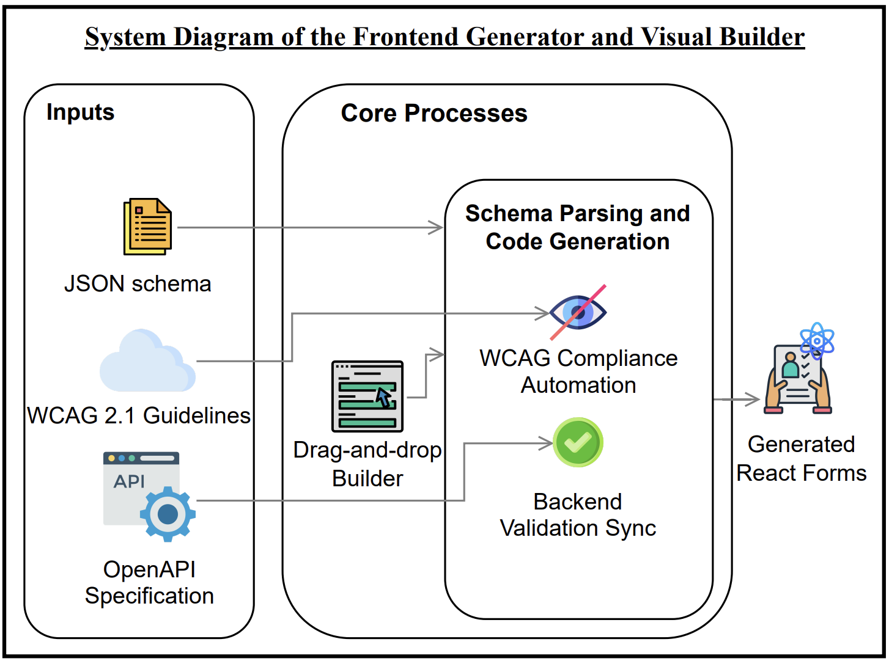
SYSTEM OVERVIEW AND REQUIREMENTS
Schema-Based Frontend Form Builder
System Overview Diagram
User / Functional Requirements
Auto-generate React forms
JSON Schema as single source
Validation sync (frontend ⬌ backend)
Drag-and-drop form builder
WCAG 2.1 compliance by default
Production-ready code output
Figure 7: System Overview - Schema-Based Frontend Form Builder
IT22350114 | Gunawardena T S | 25-26J-436

Slide 16
DESIGN EXCELLENCE & CONTRIBUTION
Schema-Based Frontend Form Builder
Design Excellence
Auto-generate React forms
FormModel as a single internal contract (framework-agnostic)
Strict JSON-serializable design for safe UI ↔ API transfer
Schema→FormModel adapter isolated in core (no UI parsing logic)
Fail-safe type mapping + stable field IDs to prevent crashes/drift
• Predictable builder state via Context + Reducer (clean, scalable editing)
Already Implemented:
JSON Schema → FormModel conversion
Visual form builder shell (3-panel layout)
Global theme customization (live preview)
Download formatted React project
To be Implemented:
Field selection and property editing
Drag-and-drop field reordering
Accessibility (WCAG 2.1) rule enforcement
Advanced layout and style optimizations
IT22350114 | Gunawardena T S | 25-26J-436

Slide 17
IT22332608 | LIYANAGE M I H
Data Mapping Engine with AI Test Case Generation
Software Engineering
IT22332608 | Liyanage M I H | 25-26J-436

Slide 18
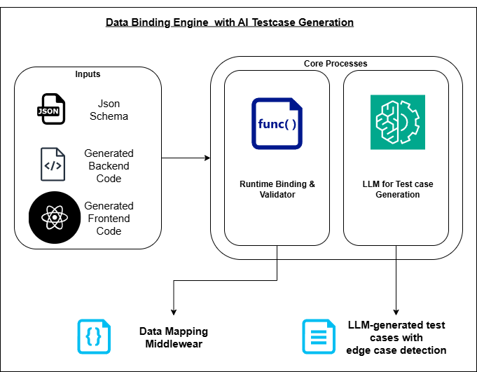
SOLUTION & USER REQUIREMENTS
Data mapping Engine with AI Test Case Generation
User / Functional Requirements
Downloads Zipped Spring Boot backend JSON Schema
Ensures schema-based validation across the controller layer
Ensures DTOs and Frontend Seamless Connectivity
Produces Test Cases using AI
User Requirement Addressed
Faster backend setup
Standard REST CRUD structure
AI generated Test Case Scenarios
Reduced development and testing effort
Figure 8: System Overview – Data Mapping Engine with AI test case generation
IT22332608 | Liyanage M I H | 25-26J-436

Slide 19
DESIGN EXCELLENCE & CONTRIBUTION
Data mapping Engine with AI Test Case Generation
Design Excellence
Schema to complete backend server
Generating backend server with the proper modularity of the code
Proper error/exception handling
Used Plugin Architecture for extensibility.
Already Implemented:
Runtime Binding & Validator : A Zipped Spring boot project file downloads with the Controllers to map the frontend and DTO
To be Implemented:
Test Case Generation using LLM
Extend the support for multiple backend frameworks / multiple forms in the same project
IT22332608 | Liyanage M I H | 25-26J-436

Slide 20

User Feedback
Use Spring Boot with Maven for backend projects
Add a schema-based scoring system
Provide a clear documentation guide
Store JSON schemas in a database for reuse
Support multiple form generation within one project
Allow editable frontend form previews
Enable assigning a name to each schema for easier management
Combine verify, validate, and AI enhancement into a single action
25-26J-436

Slide 21
Commercialisation Potential
Target Users: Enterprises, SaaS platforms, low-code/no-code builders, internal IT teams
Value Proposition: Reduce form development time, errors, and accessibility risks
Integration Model: Can be offered as a developer tool, platform plugin, or standalone service
Revenue Options:
Subscription-based SaaS (per project / per team)
Enterprise licensing (custom integrations & support)
Low-code builders
Scalability: Schema-driven architecture enables reuse across domains (HR, healthcare, finance, e-government)
25-26J-436

Slide 22
THANK YOU!
25-26J-436

